Slide 1
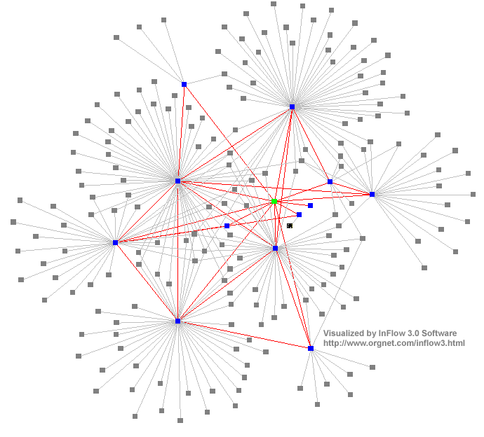
Introduction to Distributed Systems
Dr. Sunny Jeong. spjeong@uic.edu.hk
Mr. Bill Junru ZHONG billjrzhong@uic.edu.hk
With Thanks to Prof. G. Coulouris, Prof. A.S. Tanenbaum and Prof. S.C Joo

Slide 2
Distributed Systems
A distributed system is:
  Distributed system is one in which components located at networked computers communicated and coordinate their actions only by passing message –G. Coulouris
  A collection of independent computers that appears to its users as a single coherent system. - S. Tanenbaum
It leads to concurrency of components, lack of a global clock and independent failures of components
- Characteristics of distributed systems
  Concurrency
  No Global clock
  Independent failures

Slide 3
Why Distributed Systems?
Main features
  Geographical distribution of autonomous computers
  Communication through cable/fiber/wireless/...connections
  A collection of independent computers that appears to its users as a single coherent system logically( called a single view system).
  Advantages
    interaction, co-operation, and sharing of resources
  Benefits
    reduced costs, improved availability and performance
    Scalability, resource sharing, fault tolerance.

Slide 4
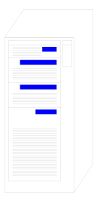
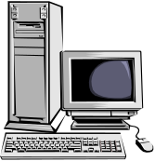


Distributed Systems
0. Distributed system ?
Autonomous systems
- Computer network
- Distributed software
Data
Communication Network
Data
0. Important consequences
Concurrency
- No global clock
Independent failure

Slide 5
Distributed Systems- consequences
Concurrency
  web pages /
  sharing resources
No Global clock
  No single global notion of the correct time
Independent failures
  slow network /unexpected termination
  each component of the system can fail independently

Slide 6
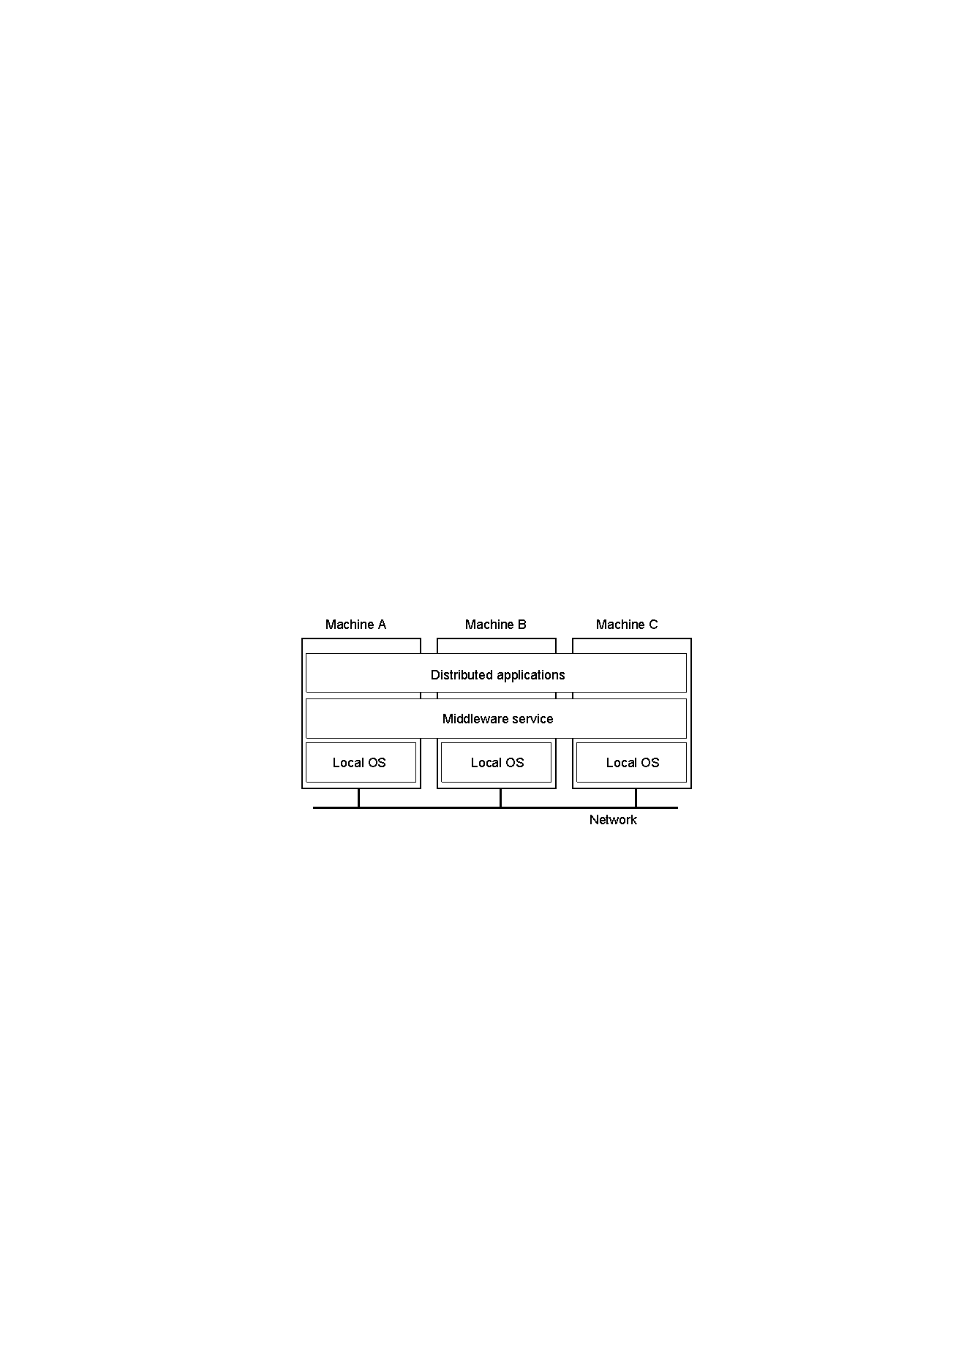
Introduction of Distributed Systems
Definitions of Distributed Systems
  A collection of independent computers that appears to its users as a single coherent system.
  A distributed system organized as middleware.
    Note that the middleware layer extends over multiple machines.

Slide 7
D.S and Processes
A distributed system is a collection of autonomous computers interconnected by a computer network and equipped with distributed system software to form an integrated computing facility.
Processes
  execute concurrently
  interact in order to co-operate to achieve a common goal
  co-ordinate their activities and exchange information by means of messages transferred over a communication network
Data
Communication
Network
Data

Slide 8
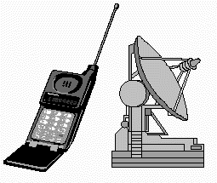
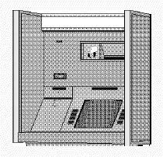
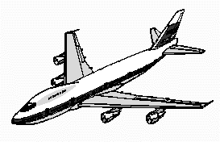
Importance of Distributed Computing
Distributed (computer) systems are critical for functioning of many organizations
Banks Transport Telecommunications
Distributed Application
  A set of processes that are distributed across a network of machines and work together as an ensemble to solve a common problem

Slide 9
Typical examples
The Internet
  global network of interconnected computers which communicate through IP protocols
  A vast interconnected collection of computer networks of many different types.
An Intranets
  a separately administered network with a boundary that allows to enforce local security policies
  A portion of the Internet. Router/firewall exclusive File services/ Impeding Firewalls/The cost of installation
Mobile and ubiquitous computing
  laptops, PDAs, mobile phones, printers, home devices, ...
  technological advance in device miniaturization and wireless networking.
World-Wide Web
  system for publishing and accessing resources and services across the Internet
  HTML/URLs/HTTP/Dynamic Pages

Slide 10
A typical portion of the Internet
intranet
%
ISP
%
%
%
backbone
satellite link
desktop computer:
server:
network link:

Slide 11
Characteristics of Internet
very large and heterogeneous
enables email, file transfer, multimedia communications, WWW,...
open-ended
connects intranets (via backbones) with home users (via modems, ISPs)

Slide 12
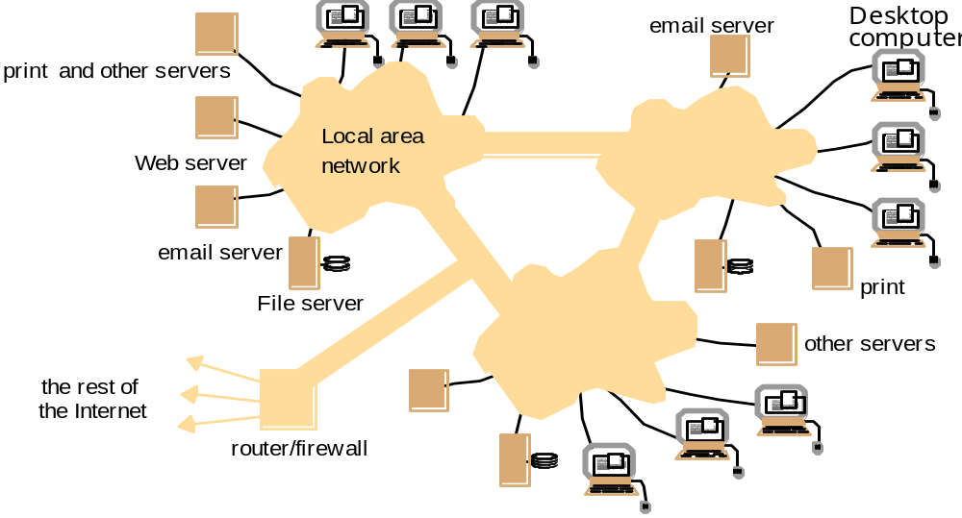
A typical Intranet

Slide 13
Characteristics of intranets
Several LANs linked by backbones
Enables information flow within an organization
  electronic data, documents, …
Provides various services
  email, file, print servers,...
often connected to Internet via Router
in/out communications protected by Firewall

Slide 14
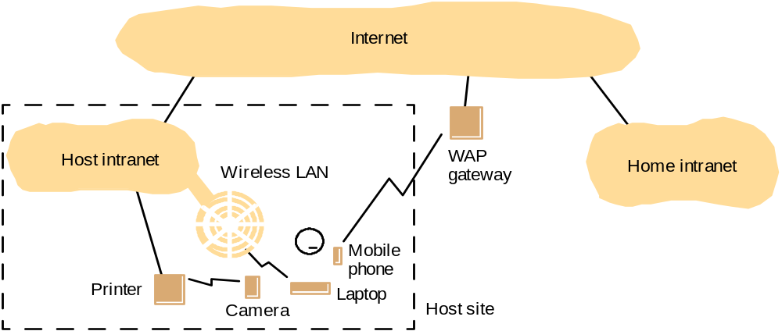
Portable and handheld devices

Slide 15
Mobile & ubiquitous computing
Wireless LANs (WLANs)
  connectivity for portable devices (laptops, PDAs, mobile phones, video/dig. cameras, …)
  Uses WAP (Wireless Applications Protocol)
Home intranet(= home network)
  devices embedded in home appliances ( hi-fi, washing machines, …)
  universal ‘remote control’ + communication
  future ➔ environment for applying embedded systems, ubiquitous computing

Slide 16
Web servers and web browsers
http://www.google.comlsearch?q=kindberg
www.google.com
Web servers
Browsers
www.cdk3.net
Internet
http://www.cdk3.net/
www.w3c.org
File system of
http://www.w3c.org/Protocols/Activity.html
www.w3c.org
Protocols
Activity.html

Slide 17
WWW
world-wide resource sharing over Internet or Intranet
based on the following technologies:
  HTML (HyperText Markup Language)
  URL (Uniform Resource Locator)
  Client-Server architecture
Open system
  Open-ended
  can be extended, re-implemented, ...

Slide 18
Distributed Systems’ Challenges
Challenges
  Heterogeneity
  Openness
  Security
  Scalability
  Failure handling
  Concurrency
  Transparency
Due to:
  complexity
  size
  changing technologies
  society’s dependence

Slide 19
Computers in the Internet
Date
Computers
Web servers
1979, Dec.
188
0
1989, July
130,000
0
1999, July
56,218,000
5,560,866
2003, Jan.
171,638,297
35,424,956

Slide 20
Computers vs. Web servers in the Internet
Date
Computers
Web servers
Percentage
1993, July
1,776,000
130
0.008
1995, July
6,642,000
23,500
0.4
1997, July
19,540,000
1,203,096
6
1999, July
56,218,000
6,598,697
12
2001, July
125,888,197
31,299,592
25
2003
42,298,371
2014
968,882,453
2015
863,105,652

Slide 21
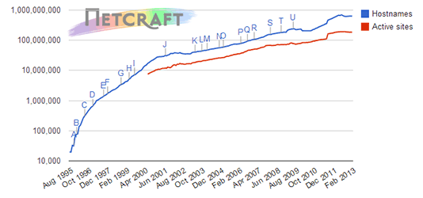
Total Sites Across All Domains
August 1995 - September 2013 -netcraft.com

Slide 22
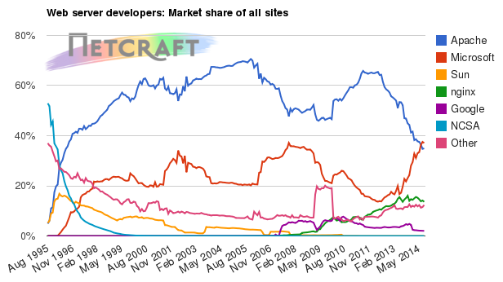
Market Share for Top Servers Across All Sites
-netcraft.com

Slide 23
Distributed Systems’ Challenges
Heterogeneity
  Networks, hardware, OSs, P-languages…etc.
  Solution-Protocol, middleware.
Openness
  Cumbersome & slow moving - follow standardization
Security
  Hospital/E-commerce/banking
Failure handling
  Software/hardware - proper policies
Concurrency
  Sharing resource at the same time - operation should be synchronized
Scalability / Transparency

Slide 24
Heterogeneity
varying software and hardware
  OSs, networks, computer hardware, program languages, implementations by different developers
  need for standards of protocols, middleware
Heterogeneity and mobile code support
  virtual machine approach (cf, Java applets)

Slide 25
Openness
independence of vendors
publishable key interfaces
  CORBA(Common Object Request Broker Architecture)
publishable communication mechanisms
  Java RMI(Remote Method Invocation)

Slide 26
Security
confidentiality (protect against disclosure)
  cf, medical records
integrity (protect against alteration and interference)
  cf, financial data
Need encryption and knowledge of identity
  Denial of Service attacks->Distributed DoS
  Security of mobile code

Slide 27
Scalability
Design of scalable distributed systems
  Controlling the cost of physical resource
  Controlling the performance loss Preventing software resource running out
  Avoiding performance bottleneck
  Examples of scalability limitations
Concept | Example
Centralized services | A single server for all users
Centralized data | A single on-line telephone book
Centralized algorithms | Doing routing based on complete information

Slide 28
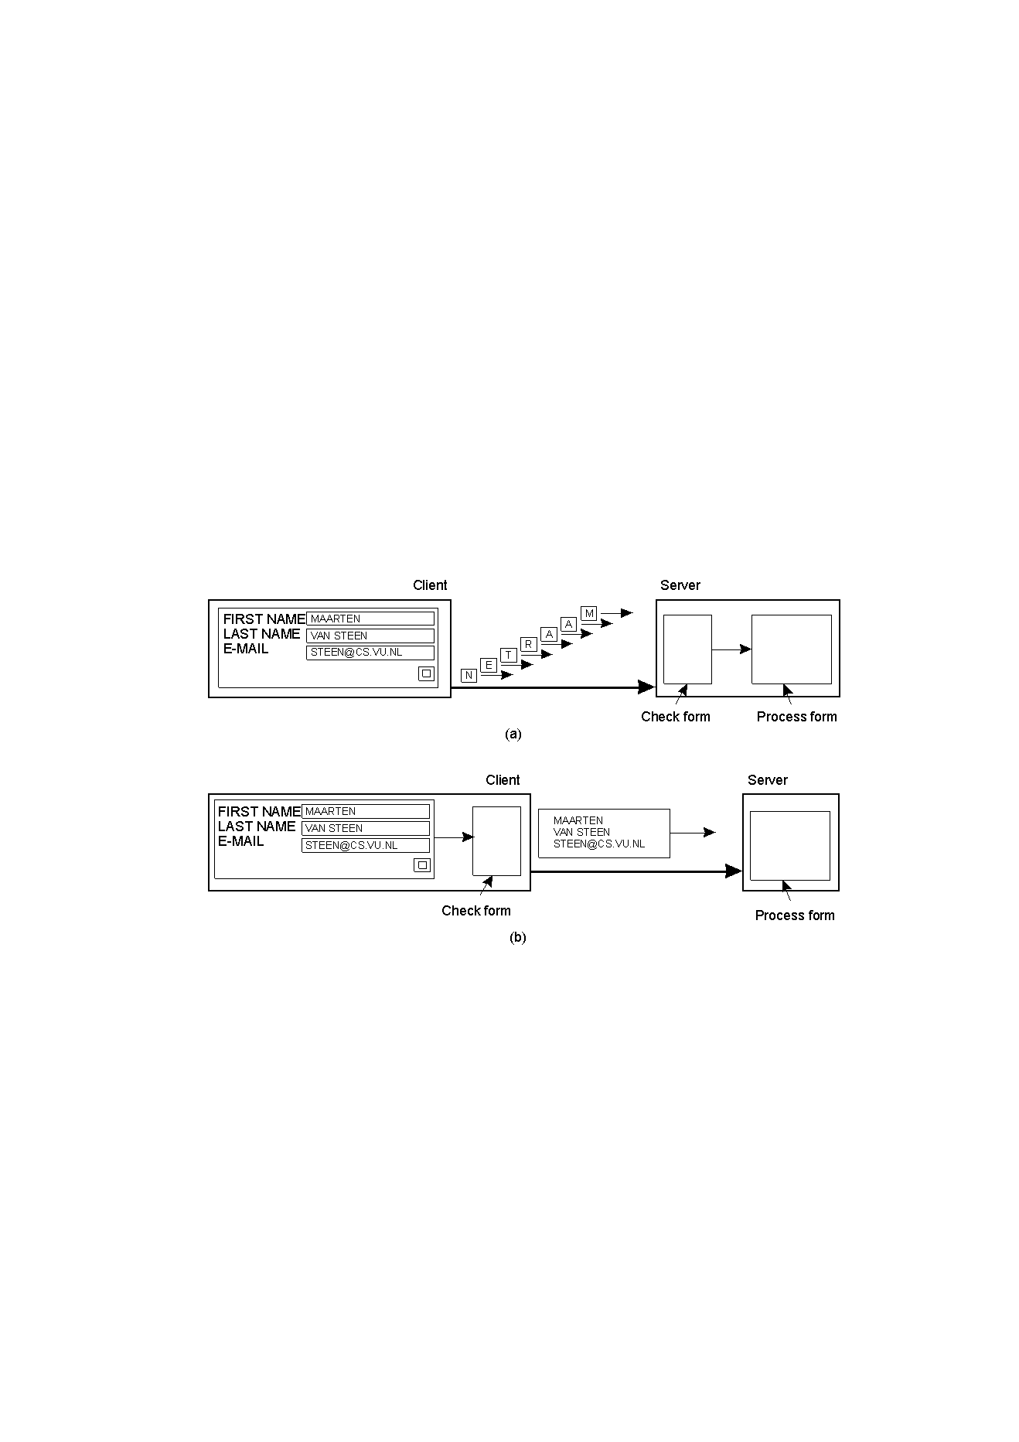
Scalability Techniques (1)
The difference between letting: No. of servers or clients
a server or
a client check forms as they are being filled
Thin
Thick(=fat)
Thick(=fat)
Thin

Slide 29
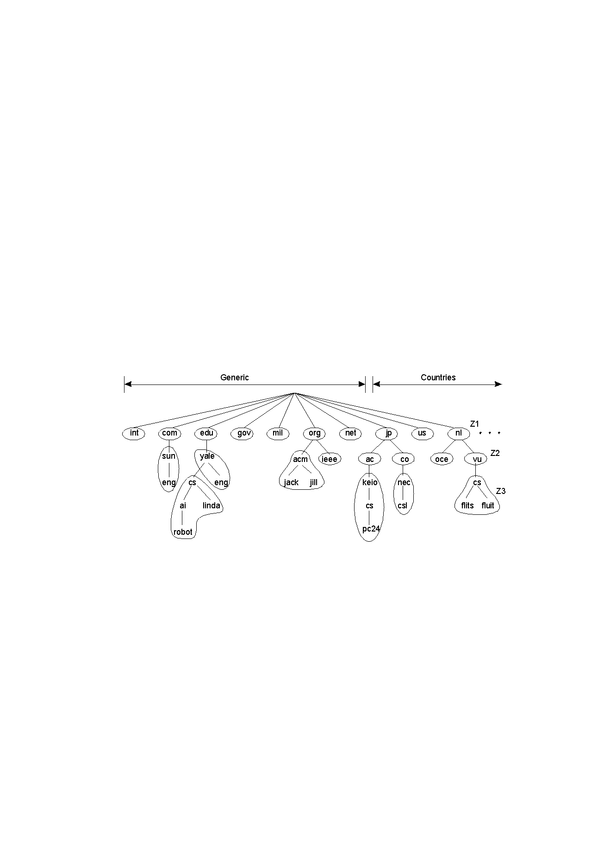
Scalability Techniques (2)
An example of dividing the DNS name space into zones

Slide 30
Scalability
Characteristics of decentralized algorithms:
  No machine has complete information about the system state.
  Machines make decisions based only on local information.
  Failure of one machine does not ruin the algorithm.
  There is no implicit assumption that a global clock exists.

Slide 31
Failure handling
Ability to continue computation in the presence of failures.
Detecting failures
Masking failures(= hiding failure)
Tolerate failures
Recovery from failures
Redundancy

Slide 32
Concurrency
Processes execute simultaneously and share resources.
synchronization
inter-process communication(IPC)

Slide 33
Transparency
Concealment of the separated nature of system from user/programmer
=>Network transparency
  Access transparency + Location Transparency
  cf .log on, email, …. on network
Transparencies=> By ANSA Reference Manual & ISO Reference Model for Open Distributed Processing (RM-ODP)

Slide 34
Transparencies(1) G. Coulouris
Access transparency: enables local and remote resources to be accessed using identical operations.
Location transparency: enables resources to be accessed without knowledge of their physical or network location (for example, which building or IP address).
Concurrency transparency: enables several processes to operate concurrently using shared resources without interference between them.
Replication transparency: enables multiple instances of resources to be used to increase reliability and performance without knowledge of the replicas by users or application programmers.

Slide 35
Transparencies(2) G. Coulouris
Failure transparency: enables the concealment of faults, allowing users and application programs to complete their tasks despite the failure of hardware or software components.
Mobility transparency: allows the movement of resources and clients within a system without affecting the operation of users or programs.
Performance transparency: allows the system to be reconfigured to improve performance as loads vary.
Scaling transparency: allows the system and applications to expand in scale without change to the system structure or the application algorithms.

Slide 36
Transparency (A. Tanenbaum)
Transparency | Description
Access | Hide differences in data representation and how a resource is accessed
Location | Hide where a resource is located
Migration | Hide that a resource may move to another location
Relocation(mobility) | Hide that a resource may be moved to another location while in use
Replication | Hide that a resource is replicated
Concurrency | Hide that a resource may be shared by several competitive users
Failure | Hide the failure and recovery of a resource
Persistence | Hide whether a (software) resource is in memory or on disk

Slide 37
Summary
Introduction to Distributed Computing Systems
pervasive in society
Consequences
  Concurrency
  No global clock
  Independent failure
use a variety of technologies
understanding underlying concepts and issues important in their management, implementation, programming
DS’s challenges
  Heterogeneity
  Openness
  Security
  Scalability
  Fault handling
  Concurrency
  Transparency

Slide 38





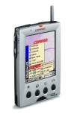


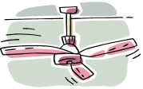



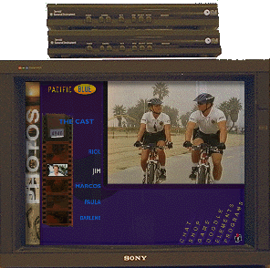














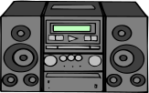


Overview of Internet Information Appliances
Window & Curtain
Bluetooth
Camera
Light
Bluetooth
Camera
PDA
FAN
PDA
IS95C
Crime
prevention
WLAN/
Bluetooth
Web PDA
Web PDA
IEEE 1394
Camera
Water
detector
HomePNA
/LAN
IEEE
1394
Game
Heats
LAN
Home Server
Home
Gateway
DTV
Digital Audio
PLC(Programming Logic Controller)

Slide 39
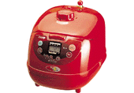
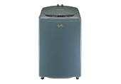

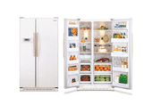
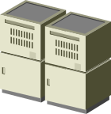
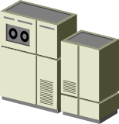

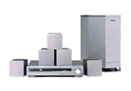
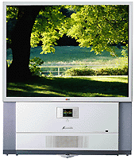
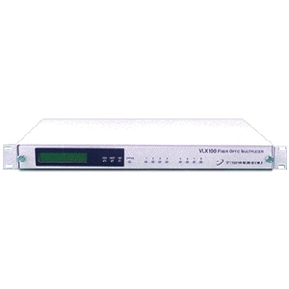
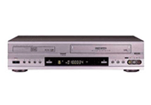
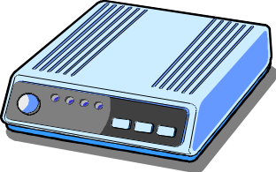
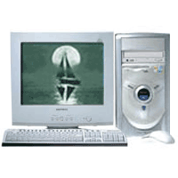

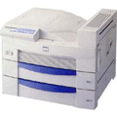

Information Appliance
Control Middleware
Home Server
Service Provider
Application
Appl.Manager
MiddleWare
Home Automation Control
JVM
RTOS
LonWorks
Service or
Device
Control Module
Home GW
HAVi
UPnP, Jini
Home Theater
ADSL…
Home Network
PLC,1394, PNA,
Ethernet
Bluetooth, RF,
IrDA, 802.11
Internet
Control
panel
Control
Control
Home Office

Slide 40
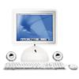
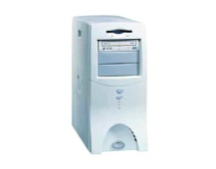
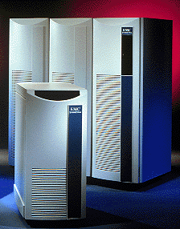

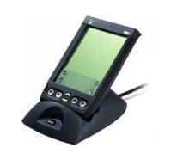

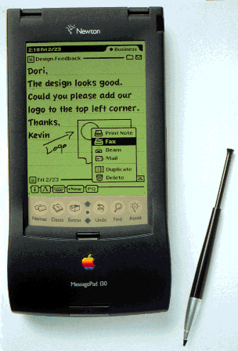
Mobile Collaboration for Information Appliance
Internet PC
PC
Home
Server
1
2
DTV STB
3
HDD
MoCos
Server
Mobile Whiteboard
+ Chat
4
5
Collaborative
Browsing
Secure P2P
Mobile
Instance Messaging

Slide 41
Electronic Health Care Systems
Questions to be addressed for health care systems:
  Where and how should monitored data be stored?
  How can we prevent loss of crucial data?
  What infrastructure is needed to generate and propagate alerts?
  How can physicians provide online feedback?
  How can extreme robustness of the monitoring system be realized?
  What are the security issues and how can the proper policies be enforced?

Slide 42
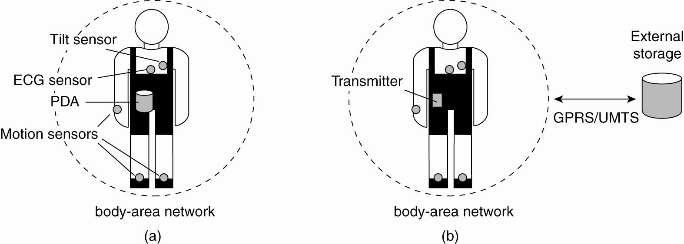
Electronic Health Care Systems (2)
Monitoring a person in a pervasive electronic health care system,
using (a) a local hub or (b) a continuous wireless connection.

Slide 43
Pitfalls when Developing
Distributed Systems
False assumptions made by first time developer:
  The network is reliable.
  The network is secure.
  The network is homogeneous.
  The topology does not change.
  Latency is zero.
  Bandwidth is infinite.
  Transport cost is zero.
  There is one administrator.

